Slide 1
Looking for strategies to improve cancer outcomes
Cancer
1.94/1000
. . .
1950
Heart diseases
5.87/1000
Cancer
1.86/1000
. . .
2008
Heart diseases
2.03/1000
Moore NM, Kuhn NZ, Hanlon SE, Lee JSH and Nagahara L 2011 De-convoluting cancer’s complexity: using a ‘physical sciences lens’ to provide a different (clearer) perspective of cancer Phys Biol 8 010302

Slide 2
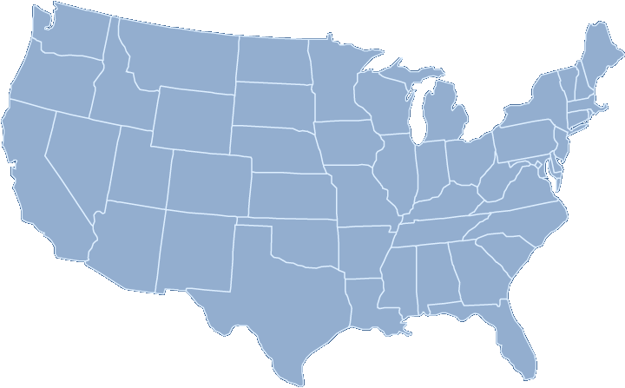
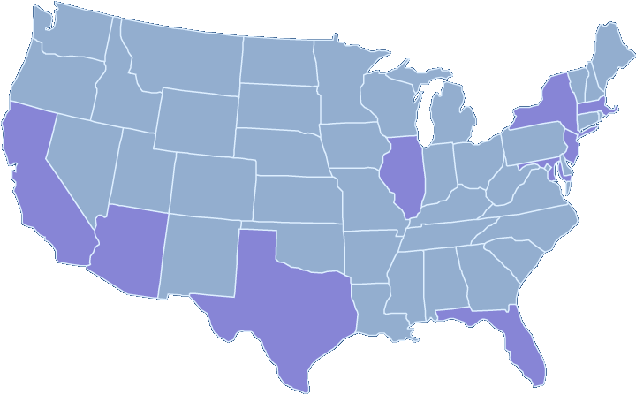
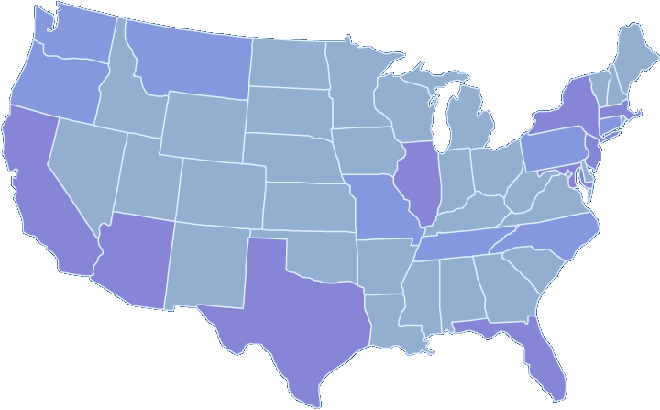
National Cancer Institute Physical Sciences Oncology Centers
$150 million, 5 years, 12 collaborative centers
Heterogeneity
Evolutionary dynamics
Measurement
Concepts
Moore NM, Kuhn NZ, Hanlon SE, Lee JSH and Nagahara L 2011 De-convoluting cancer’s complexity: using a ‘physical sciences lens’ to provide a different (clearer) perspective of cancer Phys Biol 8 010302

